Slide 1

A PUBLIC LECTURE, BAYVIEW COMMUNITY COLLEGE
The Civilian Conservation Corps
And the roots of federal environmental stewardship. Juan Hernandez, October 22, 2026.

Slide 2
What we will cover
• The country in 1933, and why conservation had no backbone.
• What the Corps actually built across the land.
• By the numbers, the scale of the effort.
• The institutions it left behind.
• From a 1930s planting crew to present climate policy.
• Questions and discussion.
The Civilian Conservation Corps - a public lecture by Juan Hernandez.

Slide 3
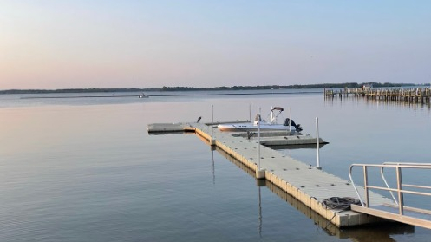
Part one
The problem in 1933

Slide 4
The Corps by the numbers
3
Measure | Figure
Years in operation | 1933 to 1942
Young men enrolled | About 3 million
Camps at the peak | About 4,500
Trees planted | About 3 billion
Monthly pay | $30, with $25 sent home
Relief and conservation, at the same time.
A quarter of the workforce was idle. The Corps put young men to work on the land and sent most of their wages home to families.
Figures are rounded. Source, standard New Deal program histories.

Slide 5
From a planting crew to a public duty
4
What the Corps started | What it became
Coordinated tree planting and erosion control | A standing federal role in land management
Survey and mapping field work | Durable scientific capacity inside the agencies
Trails, fire towers, and park infrastructure | A park system the public still uses
The idea that stewardship is public work | The bureaus I worked in for thirty five years
The line from the 1930s to a modern land management plan is shorter than people assume.
The institutions it left behind.

Slide 6

The Corps is not a museum piece.
Thank you. I look forward to your questions.

